Slide 1
Intro to Object Recognition Using Neural Networks
Finally, a use for all those cat videos
Presenter: Edward Preble
DOG
CAT

Slide 2
Intro
Edward Preble, Data Scientist at RTI International
NCSU Institute for Advanced Analytics Class of 2017
Background:
Degrees in science and engineering (nuclear eng., materials science)
Worked in semiconductor industry for 15 years
All slides and code on my github page: https://github.com/epreble/
Intro
CNN Details
Applications
Caution
Wrap Up

Slide 3
Neural networks are sooooo complicated…. do I really need to care???
YES

Slide 4
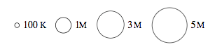
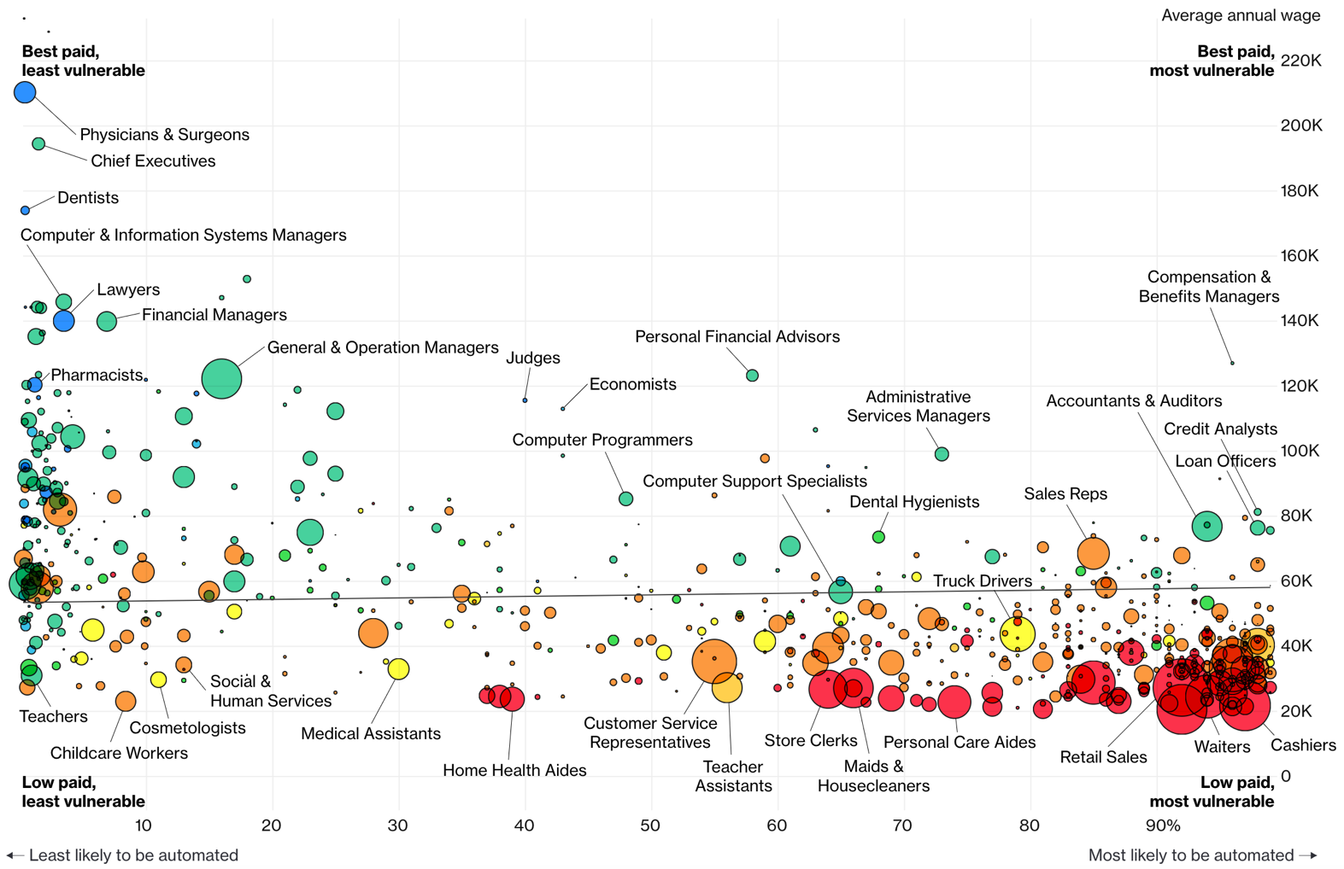
Jobs likely to be displaced by automation (esp. Neural Networks)
Bloomberg 7/2017

Slide 5
Agenda
Introduction
How to Use a Convolutional Neural Network (CNN)?
Tensorflow Playground CNN Demo
Transfer Learning
Application of CNNs in Image Analysis
Image Classification, Object Detection
Cautionary notes
*After Presentation - Optional Attendance Tech Demo
~20mins long
How to extract training images from videos
Live build of Face Recognition model
Intro
CNN Details
Applications
Caution
Wrap Up

Slide 6
Projects at RTI over last 18 months
Data Visualization
Visualize publication details for the International Space Station
Police body-worn camera meta-data visualization
Federal Contract data visualization
Modeling Related
Custom object detection in drone videos
Determine land use in Rwanda via satellite imagery
Seizure detection using ECG sensor
Determine physiological impact of lighting conditions on workers
Detect traumatic brain injury in ECG sensor data
Financial risk simulation
Drone route optimization for medical test kit delivery
Pre-symptomatically detect if someone is sick
Personnel retention modeling
Software Development
Aerosol penetration of protective clothing
Business Related
Confidential Client – AI Research
Confidential Client – Locate novel data sources for client needs
Tech Used
SQL
SQL
SQL, VBA
CNNs
CNNs
Logistic
Logistic
Logistic
Monte Carlo
Optimization
XGBoost
XGBoost
Custom Python
Report
Report
Intro
CNN Details
Applications
Caution
Wrap Up

Slide 7
Agenda
Introduction
How to Use a Convolutional Neural Network (CNN)
Tensorflow Playground CNN Demo
Transfer Learning
Application of CNNs in Image Analysis
Image Classification, Object Detection
Cautionary notes
Intro
CNN Details
Applications
Caution
Wrap Up

Slide 8
What is a CNN?
Network
Interconnected things, sometimes in complex ways
Neural Network
“Neural” because it’s modelled (simplistically) on the human brain
Convolutional Neural Network
Combine 2+ math functions into 1
Intro
CNN Details
Applications
Caution
Wrap Up
Notes:
Neural networks, just like the human brain, there are parts that specialize in different things, like motor skills or vision, a deep neural network also has specializations in the network as well.

Slide 9
How are CNN’s going to automate jobs?
CNN’s are enabling a big leap for sensory data processing (auditory, visual, IoT sensors)
Image Recognition Accuracy
95-98% accuracy is a typical benchmark to outperform humans
Intro
CNN Details
Applications
Caution
Wrap Up

Slide 10
CNN Diagram for Image Analysis
All Image Pixels
Edges/Curves
Eyes/Nose
Dog
Input Data
Input Layers
Detection Filters
Simple Features
Detection Filters
Complex Features
Classification
Inception v3
(Google CNN Architecture)
Intro
CNN Details
Applications
Caution
Wrap Up

Slide 11
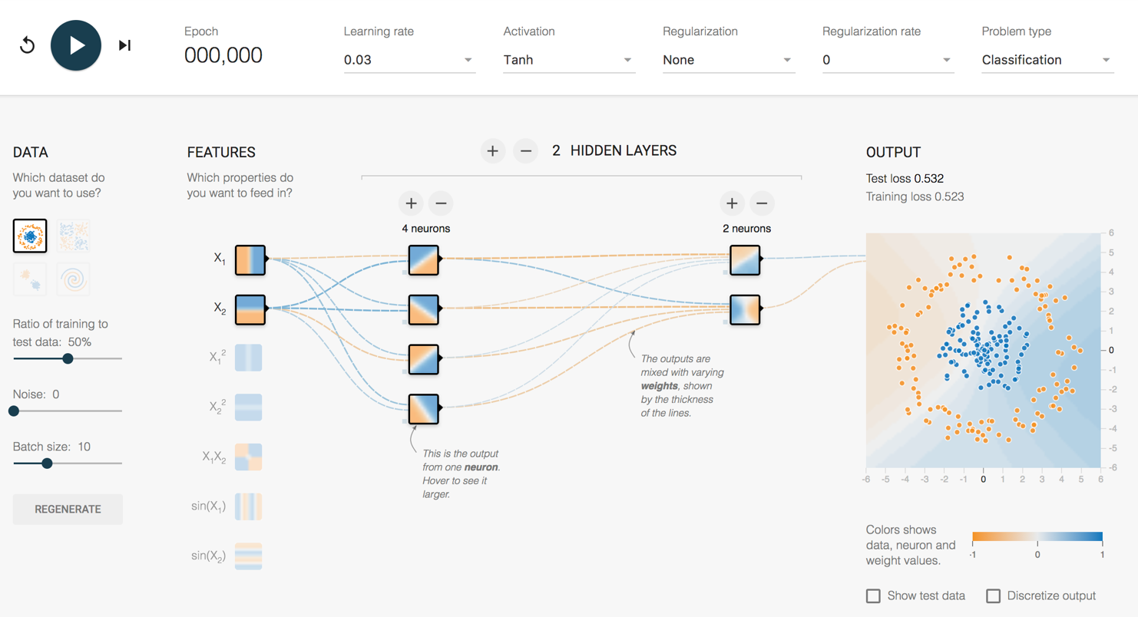
How does it work?
http://playground.tensorflow.org/
Intro
CNN Details
Applications
Caution
Wrap Up

Slide 12
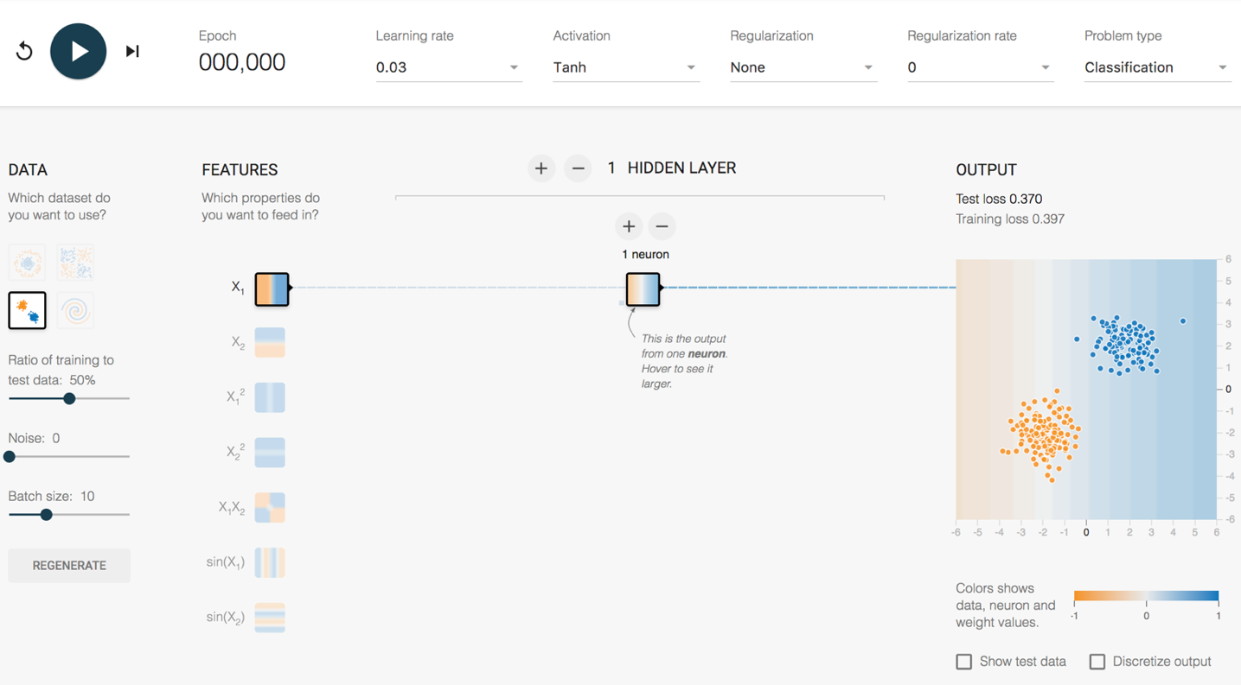
Playground Demo 1
2 Clumps 1 Feature 1 Hidden Layer
1 Neuron
Intro
CNN Details
Applications
Caution
Wrap Up
Notes:
Maybe this is data from Orange sneakers and Blue sneakers that your boss needs a model for.
Dividing line, left is orange, right is blue.
Look at random initial weights
Single click advance the model on the vertical feature only
Watch weights increase
Division gets clearer
Test loss gets lower and lower
Horizontal feature only
Vertical + horizontal
Show next 3 features that they don’t work
This is a fundamental problem of SHALLOW NETWORKS. Bad feature = Bad results.
Do all 5 together
Weights that increase are said to be ACTIVATED

Slide 13
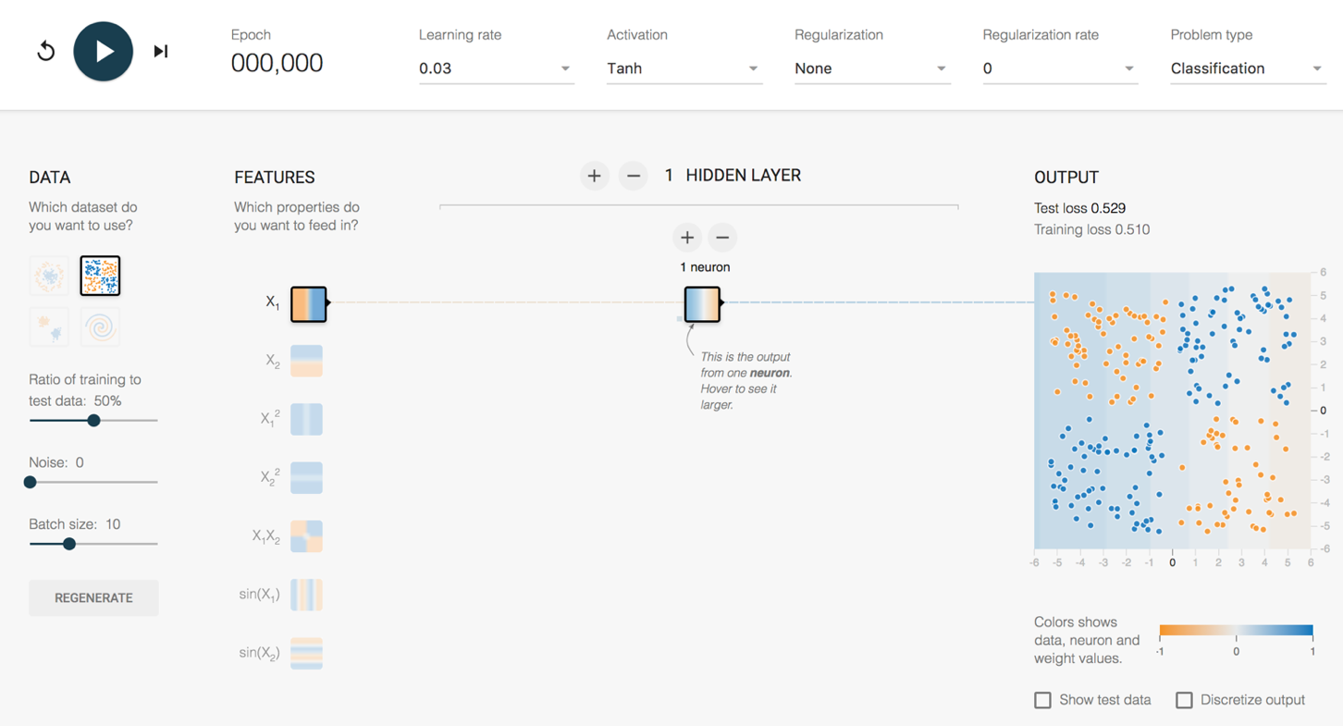
Playground Demo 2
4 Clumps 1 Feature 1 Hidden Layer
1 Neuron
Intro
CNN Details
Applications
Caution
Wrap Up
Notes:
Your boss is super excited. She says your sneaker model is awesome, so lets also use it on our data from orange and blue basketball shoes.
Lets take the same model and “TRANSFER” this model to new data.
1 feature, 1 layer, 1 neuron – terrible
2 feature, 1 layer, 1 neuron – now get an angle, better
2 feature, 2 layer, 1/1 neuron – Makes no sense to have single neuron into single neuron, can reverse info, but can’t adjust it
2 feature, 2 layer, 2/1 neuron – Sometimes single line, like above. Sometimes more of a “corner”, sometimes makes a valley (best)
Layer 2 convolves layer 1
Hover over neurons and weights for each neuron to show how it adds up
So, with a small network, what is the best way to make this work?
Use the feature that fits the data better – Choose the X1X2 feature

Slide 14
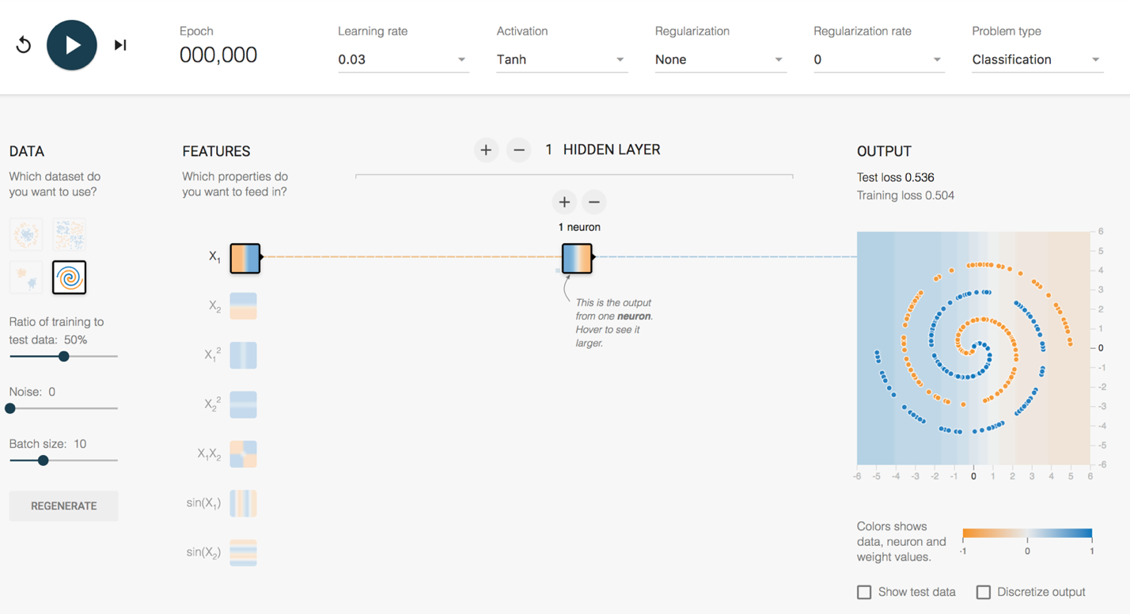
Playground Demo 3
Spiral 1 Feature 1 Hidden Layer
1 Neuron
Intro
CNN Details
Applications
Caution
Wrap Up
Notes:
So, you’re getting a good reputation with management now. You’ve solved the previously impossible orange and blue basketball shoe problem.
Now, the CEO wants you to solve some horrible manufacturing problem on all the shoes the company makes.
The data looks like this. You don’t even know what you’re looking at.
With small networks of the past, feature engineering was where everyone worked to make this stuff happen. Good features = Good model. Bad features = no luck.
But, what is the magic feature to model a spiral? This is where deep learning is going to come to the rescue.
More complex Shape – Spiral
1 feature, 1 layer, 1 neuron – terrible
All features, - starts making dots
All features , 1 layer, 2 neurons
All features – Keep trying until a partial spiral, not enough complexity to handle full spiral
All features , 5 layers, top layers are washed out. No new information being generated.
All features , 5 layers, 5/4/3/2/1, might get it
6 layers, 7/6/5/4/3/2, starts working pretty well pretty quickly – weird looking, but works
Note simple features on left, complex features on right

Slide 15

How does a CNN “Learn”?
Backpropagation
Initial network settings are random
Test it using training data
Adjust network by a certain amount (Learning Rate) to reduce the error
Start at the end of the network and work backwards
?
Dog
Dog
Dog
Dog
Label = Dog
?
Cat
X
Cat
Cat
Cat
?
?
Intro
CNN Details
Applications
Caution
Wrap Up

Slide 16
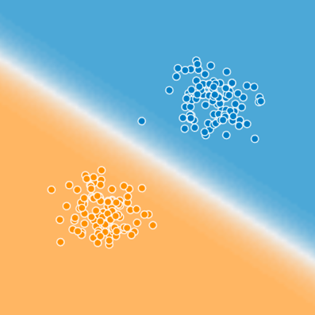

Is that it?
Blue
Cat
Typing
on
Laptop
How to get to here?
Orange
Intro
CNN Details
Applications
Caution
Wrap Up

Slide 17
Agenda
Introduction
How to Use a Convolutional Neural Network (CNN)
Tensorflow Playground CNN Demo
Transfer Learning
Application of CNNs in Image Analysis
Image Classification, Object Detection
Cautionary notes
Intro
CNN Details
Applications
Caution
Wrap Up

Slide 18
How complex are these things?
All Image Pixels
Edges/Curves
Eyes/Nose
Dog
Input Data
Input Layers
Detection Filter
Simple Features
Detection Filter
Complex Features
Classification
Inception v3
(Google CNN Architecture)
Number of Parameters = 23,200,000
Number of Layers = 48
Intro
CNN Details
Applications
Caution
Wrap Up
Notes:
Back to the structure of the CNN, and how these layers start really working for complex images.
For an image, the input layers, instead of being data points like the playground example, they will be the actual pixel values for the image. The last model I used at RTI had 704x704 pixel input images, with 3 colors (RGB), which translates into ~1.5M input neurons.
So, you feed this image into the network, certain neurons and features will “activate”, which will then output at the end, is it blue or orange? Is it a cat or a dog?
On Inception v3, the number of layers is 48, the number of parameters is ~23M, the number of multiply/add calculations per sweep is ~5B.
This is DEEP LEARNING. There is a ton going on under the hood.

Slide 19
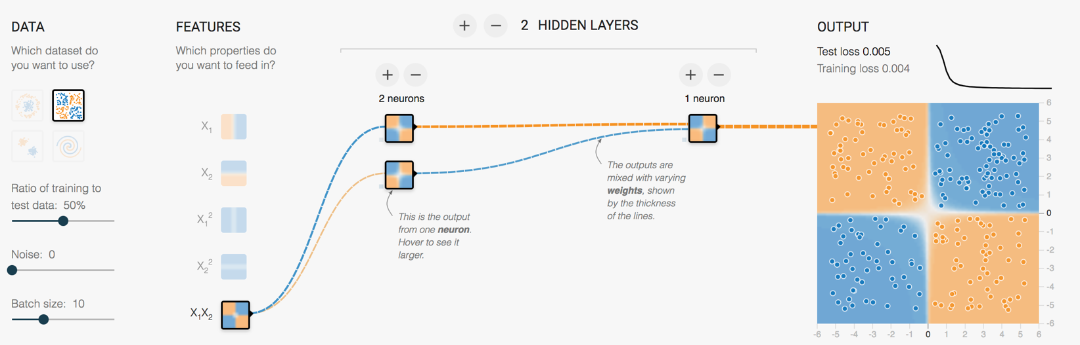
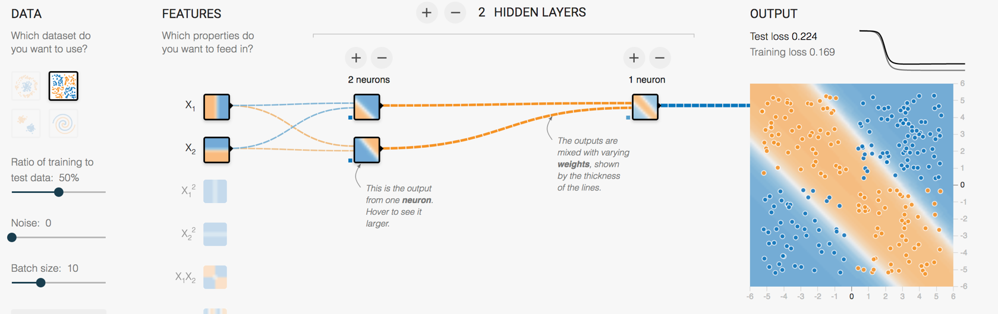
Transfer Learning is a Key Advance
Retraining the last layer is all that is needed for any human recognizable object
ImageNet trained weights for Inception v3 are downloadable
Intro
CNN Details
Applications
Caution
Wrap Up
Notes:
Remember beginning of lecture, to make the 4 blob data work, we could battle with linear features and a few layer/neuron combos
Or, just needed to use the right feature and it works instantly
Google (and others) have figured out those features and pre-trained a number of model architectures

Slide 20
Where are we today?
Great Google-centric demo→ Tensorflow for Poets
Computational platform → Tensorflow
Model architecture → Inception_v3 structure
ImageNet pre-trained weights
Retraining w/ Python scripts
Intro
CNN Details
Applications
Caution
Wrap Up

Slide 21
Agenda
Introduction
How to Use a Convolutional Neural Network (CNN)
Tensorflow Playground CNN Demo
Transfer Learning
Application of CNNs in Image Analysis
Image Classification, Object Detection
Cautionary notes
Intro
CNN Details
Applications
Caution
Wrap Up

Slide 22
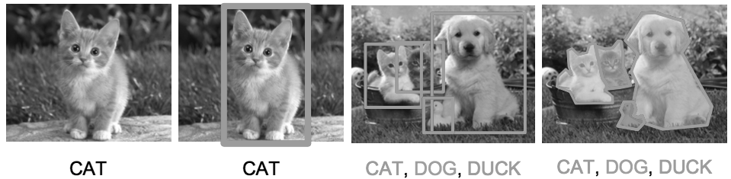
Applications of CNNs in Image Analysis
Classification
& Localization
Instance
Segmentation
Classification
Object Detection
Training Data
Labelling Time/Cost
Medium
High
3 x High
Very High
*Use video data to save time in low complexity use cases
Intro
CNN Details
Applications
Caution
Wrap Up

Slide 23
Existing Applications of Object Detection
Autonomous driving – All driving context objects
Manufacturing – Anomaly detection for quality control
Face recognition – Customer or friend identification
People counting – Store visitor or crowd counting
Online image censoring – Nudity, gore, contraband detection
Security – Automated detection of weapons, intruders
Intro
CNN Details
Applications
Caution
Wrap Up

Slide 24
Object Detection – RTI Use Case
Mosquito breeding site identification in Guatemala
Current Solution
Walking teams
Desired Solution
Target map assists walking team
Intro
CNN Details
Applications
Caution
Wrap Up

Slide 25
Agenda
Introduction
How to Use a Convolutional Neural Network (CNN)
Tensorflow Playground CNN Demo
Transfer Learning
Application of CNNs in Image Analysis
Image Classification, Object Detection
Cautionary notes
Intro
CNN Details
Applications
Caution
Wrap Up

Slide 26
3 Major Areas for Caution
Artificial Intelligence Hype
Data Bias
Model Bias
Intro
CNN Details
Applications
Caution
Wrap Up

Slide 27
Gartner Hype Cycle for 2018
Intro
CNN Details
Applications
Caution
Wrap Up

Slide 28
Data Bias
1
1
Where would you add armor?
Help the plane steer
Help the plane land
Protect the people on the plane
3
2
World War 2 Post-Mission Bomber Damage Locations
Intro
CNN Details
Applications
Caution
Wrap Up

Slide 29
Model Bias
What if a classification model is better with dogs than cats?
What if a facial recognition model is better at Caucasian faces compared with African American faces?
How might that impact real people?
Don’t ignore the ethics of how a model might be applied
Test many use cases, not just the obvious goal!
Intro
CNN Details
Applications
Caution
Wrap Up

Slide 30
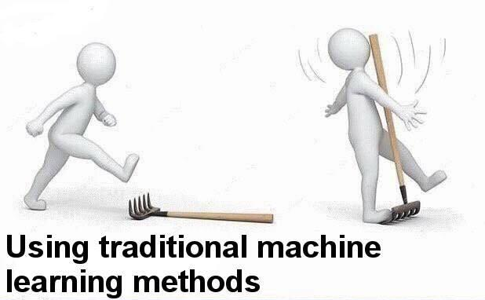
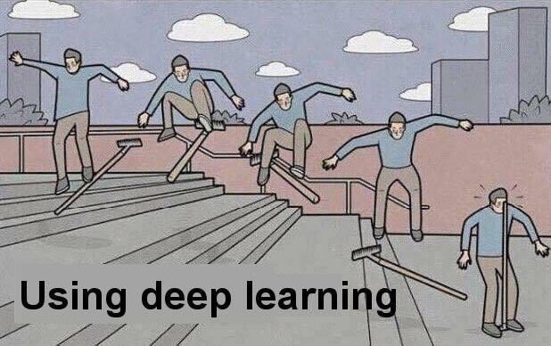
Often, Simple is Better

Slide 31
Resources to Learn More
Entry Level Videos:
Josh Gordon (Google) Machine Learning Tutorials https://www.youtube.com/watch?v=cKxRvEZd3Mw
Siraj Raval - Various Artificial Intelligence Videos https://www.youtube.com/channel/UCWN3xxRkmTPmbKwht9FuE5A
More Advanced
Adrian Rosebrock (Lots of Python and OpenCV Materials) https://www.pyimagesearch.com/
Intro
CNN Details
Applications
Caution
Wrap Up

Slide 32
Thanks!
Break, then optional 20m tech demo
2 goals for the demo:
How to use video to make lots of training data easily
Demonstrate object tracking in video
Train an Inception v3 model to recognize 3 students
Use video to get ~600 training images quickly
Train the model and test it!
Intro
CNN Details
Applications
Caution
Wrap Up

